Slide 1
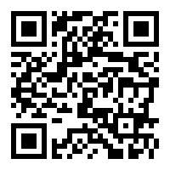
Computing and Graphics in Applied Statistics Online Instruction
LECTURE 26/April 28, 2020
Please mute yourself after joining. Unmute when you wish to speak.
This session is being recorded and will be available in Canvas.
Last class (recorded and available on Canvas)
Naïve Bayes Classifier, Bayes Regression
Today and next classes (last class is Friday, 5/1)
Complete Bayes Regression, Study guide, Project descriptions
Review HW on 5/1. Answers posted on Canvas on 5/2
Review material for Test 2 on 5/1
Student Instructional Rating Survey opened through May 7. Please complete – your feedback is important.
https://sirs.ctaar.rutgers.edu/blue QR code
Index | Section | Exam Code | Final Exam Day and Time
12976 | 01 | C | Thursday, May 07, 2020: 12:00 PM - 3:00 PM

